Slide 1

BUDGET ANALYSIS FOR KCHA HOUSING PROGRAM
KING COUNTY
HEALING ASSOCIATION
SABINA BAINS
JANUARY 2022

Slide 2
OBJECTIVE
King County Healing Association, a nonprofit dedicated to helping previously incarcerated individuals re-enter their communities, needs a budget estimate for their new program to help relieve aspiring homeowners of discrimination in the housing process
KCHA will purchase homes for applicants and take care of the down payment. The new tenants can then pay off their mortgage to the organization monthly, while additionally paying back the down payment over time
KCHA has selected 5 families to assist during their first year of the program, which they plan to roll out in 3 years. The program needs to estimate the sum of down payments based on the applicant’s parole office location (applicant is required to live within the same zip code of the office if applicable), household size, and other general preferences.
The organization would ideally choose a budget of 500k for the first year
KCHA is also interested in which factors affect price the most, and if they need to add any limitations to their program

Slide 3
DATA / Methodology
Dataset used for modeling contains 21,597 house sale prices for King County, Washington sold between May 2014 and 2015
source: https://www.kaggle.com/harlfoxem/housesalesprediction
Definitions:
price: sale price of house
bedrooms: number of bedrooms
bathrooms: number of bathrooms
grade: overall grade given to the housing unit, based on King County grading system (1 – 13)
zipcode: zip code where house is located
Multiple Ordinary Least Squares Regression was performed to create the prediction model

Slide 4
Key INSIGHTS
A predicted budget of at least $556k is required to cover the down payments of all five families.
Grade, number of bedrooms, and number of bathrooms are all effective predictors on house prices. 94% of King County zip codes were significant in predicting price as well.
Among zip codes, homes in 98039, 98004 and 98112 generated the largest increases in house price.
Among continuous predictors, an increase in grade had the biggest effect on house price with a 22% expected increase per unit increase, followed by bathrooms, with a 9% expected increase in sales per additional bathroom.

Slide 5
Family 4 ACCOUNTED FOR THE BIGGEST CHUNK OF THE BUDGET, requiring A DOWN PAYMENT OF almost 196k
The predicted budget needed to purchase homes for all 5 families is at least $555,691, assuming a down payment of 30%.
Family 4 requires a predicted $196k due to their preference of a 4 bedroom, 3 bedroom home in 98112, with a basement and grade of at least 6.
Family 5 accounted for the lowest portion of the budget at $43k due to their preference of a 1 bedroom, 2 bathroom house in 98001, with a grade of at least 5.
Total Predicted Down Payment Budget by Family
Data source: https://www.kaggle.com/harlfoxem/housesalesprediction

Slide 6
King county’s housing grade was one of the strongest predictors of price
Decreasing the grade value by one would decrease the price by about 22%
For Family 4, decreasing grade from 6 to 5 would decrease the sale price by an expected 117k (or 35k off the down payment)
Decreasing the number of bathrooms by one would decrease the price by about 9%
Decreasing the number of bedrooms by one would decrease the price by about 6%
Predictor | Correlation with sale price | Change in sale price with one unit change of predictor (%)
Grade | 0.67 | 21.8
Bathrooms | 0.53 | 9.3
Bedrooms | 0.32 | 5.5
Predicted budget required
Data source: https://www.kaggle.com/harlfoxem/housesalesprediction

Slide 7
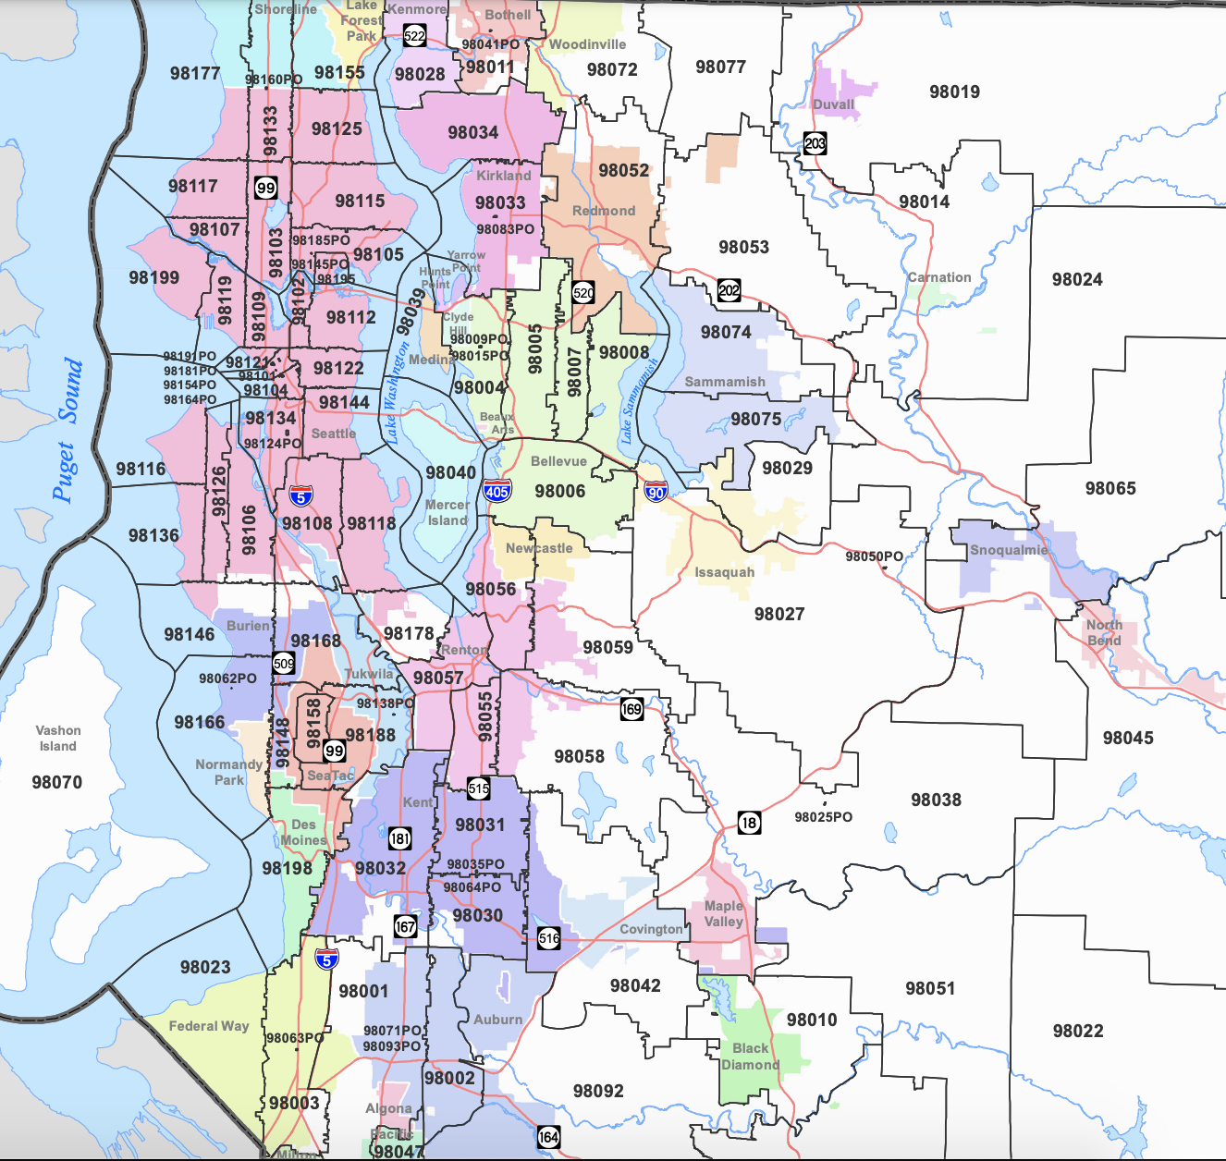
LOCATION plays an important factor in house price
Homes in zip codes 98039, 98004 and 98112 are generally expected to sell for the highest prices
It’s expected that a home in zip 98039 would increase the price by almost 4 times a house in zip 98001,
If Family 4 chose adjacent zip code 98144 rather than 98112, we’d expect a decrease of almost 62k in the down payment.
Data source: https://www.kaggle.com/harlfoxem/housesalesprediction

Slide 8


Conclusions and RECOMMENDATIONS:
KCHA can keep a budget of 500k for the first year of launch, contingent on adding limitations to their service
Consider less flexibility in applicants requesting a specific grade, as decreasing this value would expect a decrease in sales of 22%, allowing KCHA to keep families within the budget if it exceeds the limit.
Consider exceptions for requiring applicants to choose a home in the same zip code as their parole officer if these zip codes are expected to double the price.

Slide 9
APPENDIX

Slide 10
Zip codes AND THEIR EXPECTED CHANGE IN SALE PRICE compared to zip 98001
Predictor | Change in sale price if home in chosen zip rather than 98001(%)
98039 | 289%
98004 | 216%
98112 | 170%
98040 | 161%
98109 | 151%
98105 | 148%
98119 | 144%
98102 | 129%
98199 | 126%
98033 | 121%
98115 | 116%
98005 | 114%
98117 | 110%
98103 | 106%
98116 | 104%
98107 | 103%
98122 | 98%
98006 | 98%
98008 | 97%
98053 | 92%
98136 | 90%
98177 | 89%
98075 | 86%
98007 | 86%
98052 | 86%
98144 | 85%
98070 | 77%
98074 | 75%
98024 | 74%
98125 | 71%
98077 | 70%
98029 | 69%
98027 | 69%
Predictor | Change in sale price if home in chosen zip rather than 98001(%)
98034 | 68%
98072 | 68%
98126 | 64%
98065 | 61%
98011 | 56%
98118 | 54%
98155 | 53%
98028 | 52%
98014 | 52%
98133 | 50%
98166 | 48%
98059 | 45%
98019 | 44%
98045 | 43%
98056 | 42%
98010 | 40%
98108 | 35%
98146 | 34%
98106 | 27%
98038 | 20%
98178 | 19%
98022 | 17%
98058 | 17%
98055 | 14%
98148 | 13%
98198 | 11%
98188 | 9%
98168 | 8%
98042 | 8%
98031 | 6%
98092 | 4%
98023 | -5%

Slide 11
FAMILY DETAILS
Family 1 would like a 3 bedroom, 2 bathroom house in zip code 98011. They would prefer a basement and a home quality of at least 6/13
Family 3 would like a 2 bedroom, 1 bathroom house in zip code 98032. They would prefer a home quality of 10/13
Family 3 would like a 1 bedroom, 1 bathroom house in zip code 98045. They would prefer a home quality of at least 8/13
Family 4 would like a 4 bedroom, 3 bathroom house in zip code 98112. They would prefer a basement and a home quality of at least 6/13
Family 5 would like a 1 bedroom, 2 bathroom house in zip code 98001. They would prefer a home quality of at least 5/13

